Slide 1
WZB Berlin Social Science Center
Research Unit: Institutions and Political Inequality
November 7, 2017
Political Voice and Economic Inequality across Nations and Time:
Project Overview
Joshua K. Dubrow
Institute of Philosophy and Sociology, Polish Academy of Sciences
Cross-National Studies: Interdisciplinary Research and Training Program CONSIRT.osu.edu
Politicalinequality.org
dubrow.2@osu.edu
Funded by Poland’s National Science Centre (2016/23/B/HS6/03916)

Slide 2
Over a 3-year period starting Autumn 2017, Project aims to:
Advance the theory, methods, and empirical base for studying the relationship between political voice inequality and economic inequality across nations and time
Create a cross-national dataset of measures of political voice from survey and non-survey data, for 65 countries worldwide spanning 1990 - 2015
Establish an international research team

Slide 3
Political inequality is...
The existence of authority divisions – Sorokin (1927)
Structured differences in the distribution of political resources – Lijphart (1997)
When everybody’s preferences are not equally weighted in political decisions – Dahl and Lindblom (1953)
Structured differences in influence over political decisions, and the outcomes of those decisions – a synthesis

Slide 4
Political inequality is...
A dimension of both democracy and stratification – everywhere there is democracy, there is political inequality
A phenomenon distinct from other inequalities (e.g. economic and social) and that relates to other inequalities
An interdisciplinary subject

Slide 5
Political Inequality
VOICE
RESPONSE
Participation
Representation
Symbols
Policy

Slide 6
Political Inequality
“affluence and influence”
VOICE
RESPONSE
“money in politics”
Participation
Representation
Symbols
Policy
socio-economic resources and voting, protest
descriptive, party, SMOs and NGOs

Slide 7
Our main research questions:
(1) How, and to what extent, are political participation and party representation related to each other once main features of political and economic institutions are accounted for?
(2) How and to what extent does economic inequality as a macro characteristic influence political voice at the individual level?
(3) Across countries and time, how and to what extent do political voice inequality and economic inequality influence each other?

Slide 8
Macro-level Indicators of Political Voice
Levels of Voice
e.g. Proportion of political participation in a country-year
(B) Inequality of Voice
e.g. Ratio of participation for different groups, Gini, etc. in a country- year

Slide 9
Effects of V on E
Institutions
Effects of E on V
Institutions
Political Participation (P)
Economic Inequality (E)
Economic Inequality (E)
VOICE (V)
Party Representation (R)
Institutions

Slide 10
Economic Inequality and Political Voice
Economic resources:
Directly impact institutional and non-institutional forms of political participation (e.g. Verba et al 1995, Teorell 2006; Marien et al 2010) through capacities and incentives.
Impact party representation through other mechanisms, e.g. descriptive representation (Mansbridge 1999), “money-in-politics” (APSA Task Force 2004), and “affluence & influence” (e.g. Bartels 2008, Gilens 2012).
Inequalities of all kinds – economic, political, social – link together.
Economic inequality opens gaps between social groups in access to political decisions, which can deepen political voice inequality across society, and for some groups in particular.

Slide 11
Economic Inequality and Political Voice
Cross-national empirical literature on the relationship between economic inequality and democracy dates back a long way, e.g. Meltzer and Richard 1981, Acemoglu and Robinson 1999, Gradstein and Milanovic 2004, Timmons 2010.
Democracy is system of political power that allows for citizens to have a substantial say in how society should function.
Democracy depends in large part on the character of its institutions.

Slide 12
Economic Inequality and Political Voice
What is the role of institutions? Some possibilities:
Trade Unions are organized interest groups that moderate the relationship between labor and capital – it can amplify voice, and possibly reduce income inequality.
Corruption is a characteristic of political and economic institutions - some find that it is associated with income inequality and participation.
Multiple access points to political decisions can encourage voice (Solt 2008): “Presidentialism,” separation of powers between the executive and legislative branches; “Federalism,” in which the considerations of country regions are taken into account, and they have a say in how the whole society should be run.

Slide 13
Economic Inequality and Political Voice
Cross-national empirical studies of economic inequality (macro) and political participation (micro) test classic theories:
Grievance theory: the maldistribution of economic resources incites participation: the higher the level of economic inequality, the greater the political participation of the disadvantaged.
Resource theory: because economic resources are crucial to political participation, unequal economic distribution lowers the probability of political participation for everyone except for the economically privileged.
Economic inequality…
Lowers the probability of political participation for the disadvantaged (e.g. Solt 2008, 2015)
Has no relationship with political participation (e.g. Dalton et al 2010)

Slide 14
Economic Inequality and Political Voice
Cross-national empirical studies of economic inequality (macro) and party representation (micro) are even more recent and rely on the “affluence & influence” mechanisms, i.e. the economically advantaged influence the ideologies of parties:
Rosset et al 2017 found that economic inequality skews party representation – measured as issue congruence away from the disadvantaged, i.e. the ideological composition of parties in government are less similar to the disadvantaged.
This could be a long-term problem:
Keman (2011) finds that, “In spite of large electoral changes since the 1990s, party composition of government changes less and established parties stay longer in office than others regardless their electoral fortunes.”

Slide 15
Relationship between Voice Inequalities of
Political Participation and Party Representation
How and to what extent are political participation and party representation related?
What forms of political participation relate to party representation?
e.g.
Group voting should have an impact on the ideological diversity of parties in government…
But do non-institutional forms of participation influence the ideological diversity of these parties?
How does party representation relate to political participation?

Slide 16
Effects of V on E
Institutions
Effects of E on V
Institutions
Political Participation (P)
Economic Inequality (E)
Economic Inequality (E)
VOICE (V)
Party Representation (R)
Institutions

Slide 17
Measurement Considerations
Time span of analysis: 1990s to 2015
Thinking cross-national: Functional equivalence, and the data situation varies by country
Thinking across time: To account for lag effects in the relationship between economic and political inequalities
Levels of Voice and Inequalities of Voice
Combining measures of political participation and party representation

Slide 18
Some issues in measuring voice in terms of...
Political Participation
Forms of Participation: Institutional (voting, membership or working in a party, contacting a politician) and Non-institutional (signing a petition, attending a demonstration, political consumerism)
As a Macro Measure:
  -- Inequality between whom? Between those who participate and those who do not? By ”degree” of participation? Can we measure the political inequality of voice of a whole society by what proportion participates and what proportion does not?
  -- Participation by subgroups, e.g. Socio-economic (income, education, class), Social (gender, age, ethnicity), Political values (political ideologies, role of government in society) and so on.

Slide 19
Some issues in measuring voice in terms of...
Party Representation
Most cross-national studies on party representation focus on issue/ideological congruence using left-right scales (Golder and Stramski 2010), but there are considerable problems with:
  Limited data availability (e.g. best cross-national data are Comparative Study of Electoral Systems and the PRIEDEU project)
  Questions about the validity of left/right scales (e.g. Budge 2000)
Alternatively, we can focus on the difference between the diversity of the parties in government and the diversity of peoples’ party preferences (that feel close to or voted for a party, as revealed in surveys).

Slide 20
Concept | Dataset | Countries | Years Covered
Economic Inequality | Standardized World Income Inequality Database SWIID | 100 + | 1960 - 2013
Political Voice: Levels and Inequalities
Political Participation | The Harmonization Dataset | 120 + | 1966 - 2013
Party Representation (a) Party preferences | World Values Survey | 50 + | 1990 - 2014
(b) Parties in and out of government | International Parliamentarian Union | 150 + | 1945 - 2016
Institutional Characteristics
Character of political institutions | Quality of Government (QoG) | 100 + | 1990 - 2015
Level of democracy | Freedom House, Polity IV, and V-Dem | 150 + | 1990 - 2015

Slide 21
The Harmonization Dataset (formally, the SDR Database V.1)
This is a multi-country multi-years data set for comparative, cross-national research on Democracy and Political Participation. It has ex post harmonized survey data for 22 international survey projects:
Asian Barometer | International Social Justice Project
Afrobarometer | International Social Survey Programme
Americas Barometer | Latinobarometro
Arab Barometer | Life in Transition Survey
Asia Europe Survey | New Baltic Barometer
Caucasus Barometer | Political Action II
Consolidation of Democracy | Political Action - An Eight Nation Study
Comparative National Elections Project | Political Participation and Equality
Eurobarometer | Values and Political Change
European Quality of Life Survey | World Values Survey
European Social Survey
European Values Study
89 waves (i.e. project*wave) and 1,721 national surveys (i.e. project*wave*countries); 142 countries/territories, from 1966 to 2013. N= 2, 289,060 respondents.
The database & documentation are available via Harvard dataverse (see also: dataharmonization.org)
Notes:
Given our substantive interest (explaining political protest) we selected 22 projects for harmonization that meet the following criteria:…..
We took from them 1721 national surveys covering about 2,300 million respondents interviewed at various points since 1966 in about 142 countries/territories.

Slide 22
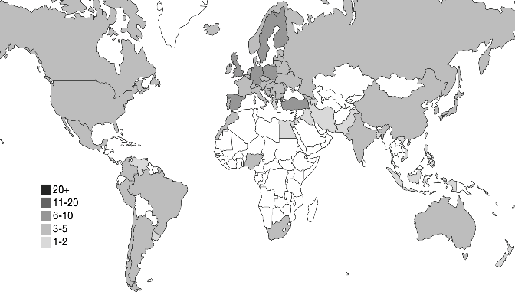
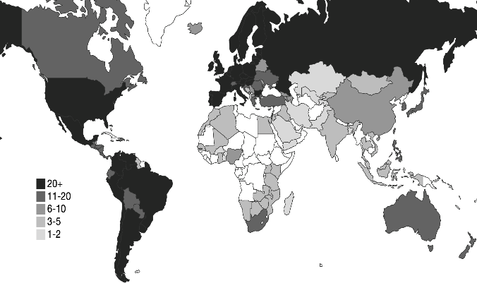
Geographical coverage before and after ex post survey data harmonization
WVS/EVS 1981-2009 (n total = 321 national surveys)
b. Harmonization Database V.1 1966-2013 (n total = 1,721 national surveys)
Notes:
We map overall country coverage in WVS/EVS, from the project’s start, up to 2009. Figure 2.b maps country coverage in the integrated SDR dataset V.1. In both maps, coverage ranges from zero (white color) to 20 or more surveys per country over the given timespan (dark grey). A comparison of these two maps shows the advantages of harmonization. It expands country coverage (e.g., in Sub-Saharan Africa, South-East Asia, Latin America). It also increases the number of surveys per country, thus facilitating over-time analyses of macro-level change with cross-sectional time series models that treat countries as repeated observations (similar to panel data).
The SDR database contains information from survey and non-survey sources. And it has a multilevel structure. Let us start with the survey data. → S9

Slide 23
Variables in the Harmonization Database - Survey variables (individual level)
Political attitudes and behaviors
Trust in the national parliament
Trust in the justice system
Trust in political parties
Trust in the government
Participation in demonstrations:
Referring to actual past participation: 0 for “no participation”, 1 for “participation”
Referring to potential participation: 0 for “would never participate”, 1 for “would participate”
Signing petitions: 0 for “no participation”, 1 for “participation”
Interest in politics
Notes:
For the variabales marked with an asterisk we performed three types of harmonization:
“stretching “ to the target scale 0-10 with 0 indicating no trust and 10 indicating maximal trust; points on the original scales (2, 4, 5, 10-point) correspond to intervals on the target 11-point scales, and are assigned mid-points of respective intervals.
“Shrinking” into the target 0-1 scale, where lowest values on the original scale are assigned 0 on the target scale, the highest value is coded 1, and the interim values are spread evenly between 0 and 1.
Distributional scale preserves the distribution of the original values in the sample. Source values, in the ascending order (from lowest to highest interest in politics) are assigned values of the mid-point from the cumulative distribution. This transformation produces a variable that contains information about the relative position of an individual in the distribution of trust in a given survey (national sample), more specifically, it tells what share of the sample has lower trust than the individual.

Slide 24
Variables in the Harmonization Database - Survey variables (individual level)
Socio-demographics
Gender (female = 1)
Age - in years (derived from year of birth where available)
Year of birth (derived from interview year and age, where no year of birth available)
Rural/urban - residence of the respondent; rural = 1, otherwise = 0
Education (levels) - adapted ISCED scale; 0 - less than primary; 8 doctoral or equivalent
Schooling years - calculated from “age at completion of education” if schooling years not available; 0 = no formal education, 18 = 18 years of schooling or more (topcoded)

Slide 25
Variables in the Harmonization Database - Country-year-level variables (macro indicators)
Available for all countries that appear in the Harmonization Database, starting in 1945, and depending on the availability of the given measure (per country-year).
GDP per capita
Freedom House ratings
Population size
Percent urban population
Population of largest city
Proportion of women in parliament
Worldwide Governance Indicators
EIU Democracy Index
Gini index (Milanovic and Solt)

Slide 26
Current Status and Future Activities
Hiring PhD students and a post-doc (Autumn 2017)
Assembling an Advisory Board (Autumn 2017 – Spring 2018)
Creating reports on concepts, theory, and measures (2018 - 2020)
Analyses, presentations, writing articles (2018 - 2020)
Workshops (2018, 2019, 2020) and Conference (2020)

Slide 27
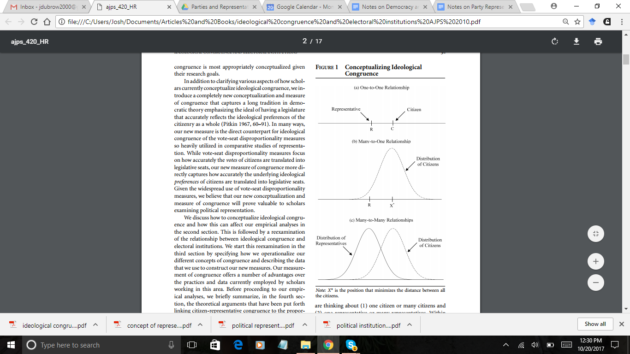

Slide 28
Structure of the SDR Database
The SDR database is a relational database whose core is the MASTER file with harmonized survey data.
Additional files (tables) contain information describing the survey process, various metadata and contextual data from publicly available sources (e.g., GDP).
Corresponding to their respective level of measurement, these additional data are stored in different Plug- files.
The Plug- files are linked to the Master file by one or more key variables in the form of one-to-many merges. Each data file is accompanied by a technical report detailing sources and data construction.

Slide 29
Variables in the SDR Database - Survey variables (individual level)
Technical variables
Interview date - date of the interview (where available)
Interview year - year of the interview (where available)
Survey year - uniform within national survey (or when the majority of interviews were conducted)
Country - country or territory (Germany: DE-E & DE-W, Israel: IL-JEW & IL-ARB, etc.)
Weight - individual case weight: design, poststratification or combined weights, as provided in the original survey data set (where available, otherwise = 1)
Notes:
Missing data codes:
-9 (.i) = missing data
-8 (.h) = question not asked in national survey
-7 (.g) = insufficient information for all response categories
-6 (.f) = insufficient information for single response category
-5 (.e) = variable not identified in data file
-4 (.d) = value not acceptable
-2 (.b) = not applicable
-1 (.a) = don't know

Slide 30
Political Inequality
VOICE
RESPONSE
Participation
Representation
Symbols
Policy

Slide 31
Political Inequality
VOICE
RESPONSE
Participation
Representation
Symbols
Policy

Slide 32
Our main research questions
(1) How and to what extent are main components of political voice inequality – political participation and party representation – related to each other once main features of political and economic institutions are accounted for?
(2) Across countries and time, how and to what extent do political voice inequality and economic inequality influence each other?

Slide 33
Main research questions
Deal with:
(1) The relation between political participation and party representation, as two main components of inequality of voice
(2) The relation between economic inequality, as a macro characteristic, and political voice at the individual level
(3) The relation between political voice inequality and economic inequality across countries and time

Slide 34
Macro-level Indicators of Political Voice
Levels of Voice
e.g. Proportion of political participation in a country-year
(B) Inequality of Voice
e.g. Ratio of participation for different groups, Gini, etc. in a country- year

